Slide 1
Bad plan! Sit!
Gail Shaw

Slide 2
Agenda
What exactly is a bad execution plan?
Symptoms
Possible causes
Options for fixing

Slide 3
What is a bad execution plan
One that uses the wrong index?
One that performs badly?
One that uses the wrong joins?
One that does table or index scans?
One that performs erratically?

Slide 4
Symptoms
Works fine today, bad tomorrow and nothing changed.
Works fine for me, bad for my colleague
Works fine one minute and bad the next.
Works fine for some parameters, bad for others

Slide 5
Possible causes
Parameter sniffing
Stale statistics
Particular query patterns
Differing set options

Slide 6
Parameter sniffing
Usually a good thing
Allows better row estimations, hence better execution plan
Sometimes has unwanted side effects
Often a problem with data skew
Notes:
Demo after this point

Slide 7
Demo

Slide 8
Stale statistics
Especially for larger tables
Especially for indexes where data is added at the end

Slide 9
Demo

Slide 10
Query patterns
Catch all queries
Multiple execution paths
Modifying parameter values

Slide 11
Example – Catch-All Query
SELECT ProductID, ReferenceOrderID, TransactionType, Quantity, TransactionDate, ActualCost
FROM Production.TransactionHistory
WHERE (ProductID = @Product Or @Product IS NULL)
AND (ReferenceOrderID = @OrderID OR @OrderID Is NULL)
AND (TransactionType = @TransactionType OR @TransactionType Is NULL)
AND (Quantity = @Qty Or @Qty is null)

Slide 12
Example – Multiple Execution Paths
CREATE PROCEDURE MultipleExecPaths (
@TransactionType char(1) = NULL
)
AS
IF @TransactionType IS NULL
SELECT max(transactionDate) from Production.TransactionHistory
ELSE
SELECT max(transactionDate) from Production.TransactionHistory
WHERE TransactionType = @TransactionType
GO

Slide 13
Example – modifying Parameters
CREATE PROCEDURE RecentOrders (
@StartingDate DATETIME = NULL
)
AS
IF @StartingDate IS NULL
SET @StartingDate = '1900/01/01'
SELECT
OrderDate ,
DestinationCountry ,
SUM(ItemPrice) AS totalPrice ,
SUM(QuantityPurchased) AS totalPurchased
FROM dbo.BookOrders AS bo
INNER JOIN dbo.OrderDetails AS od ON bo.OrderID = od.OrderID
WHERE OrderDate >= @StartingDate
GROUP BY OrderDate, DestinationCountry

Slide 14
Tracking bad plans
Symptoms
Querying the plan cache
Profiler events
Extended events

Slide 15
Tracking via Symptoms
Profiler or the query stats DMVs
Queries that have massive ranges in IO, CPU and duration
Can then be examined in Management Studio
Must be run on a near-identical copy of the DB to be useful

Slide 16
Tracking via Plan Cache
Often not practical
The plans in the cache have no run-time information
No actual row counts
The plans will look good for the estimated row counts that are included

Slide 17
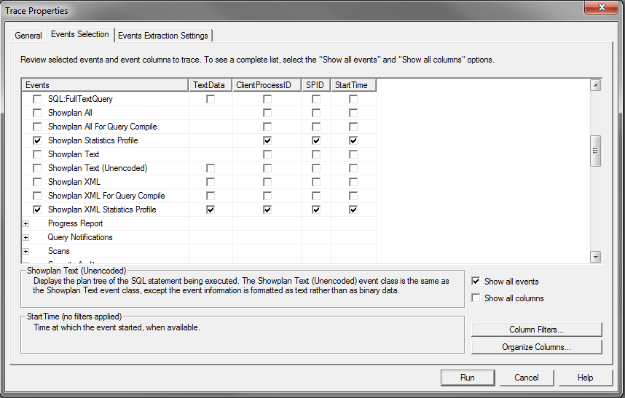
Tracking via Profiler
There are two events that return the actual execution plan
Showplan Statistics Profile
Showplan XML Statistics Profile

Slide 18
Tracking via Extended Events
Not a practical option at present
There is no extended event that provides the execution plan with run-time information
http://connect.microsoft.com/SQLServer/feedback/details/648351/extended-events-action-to-collect-actual-execution-plan

Slide 19
Fixing Parameter sniffing
Local variables
Recompile
Optimise for hint

Slide 20
Fixing stale statistics
Manual stats updates
Database-wide if there is time
Specific if only some tables exhibit the problem.
Do not turn auto-update off without having a plan in place to replace it.

Slide 21
Fixing bad query patterns
Don’t use them
If you do need to, understand the effects
Test to ensure that the effects are not detrimental

Slide 22
Last resort
Query hints
Plan guides
Make sure you know exactly what the effects are before using one

Slide 23
The very last resort
Plan forcing
Does not disable the optimiser
Plan must be a valid one

Slide 24
Resources
Performance-related articles on my blog
http://sqlinthewild.co.za/index.php/category/sql-server/performance/
Grant Fritchey
http://www.scarydba.com/

Slide 25
Professional Association for SQL Server
Thank you to our sponsor

Slide 26
Save 25%: Register by April 12th
www.sqlpass.org/sqlrally
May 11-13, Orlando, FL
Register by March31st: save 40% and have the chance to win a cruise to Alaska!
“24HR11” code gets you $100 off
www.sqlpass.org/summit
Oct 11-14, Seattle, WA

